Slide 1
CRYPTO Q Using quantum in classical crypto
TEAM 2
Alfonso de la Rocha
Álvaro Buendía
Álvaro Reyes

Slide 2
Problems we were trying to tackle
Symmetric key distribution
Diffie-Helman: Key exchanged using same channel as data
Several interactions to agree about the key
Blockchain consensus algorithms
Proof-of-work? Expensive and slow
Proof-of-stake? Problem of nothing-at-stake
Proof-of-elapsed time? I can cheat selecting my random timer.

Slide 3
Quantum Key Distribution
Use quantum entanglement to share the symmetric key
Encrypt using classical cryptography and send data using classical link.

Slide 4
Quantum Key Distribution
Use quantum entanglement to share the symmetric key
Encrypt using classical cryptography and send data using classical link.
KEY EXCHANGE. ENTANGLED STATES
ALICE
BOB
SHARE ENCRYPTED DATA

Slide 5
Quantum Key Distribution
BUT WAIT! Our key exchange could be eavesdropped or sabotaged!
Simulating Eve’s effect and adding a parity bit to detect this matter.
KEY EXCHANGE. ENTANGLED STATES
ALICE
BOB
SHARE ENCRYPTED DATA
EVE
(NED)

Slide 6
How did we do it? Our parity circuit!
We implemented a basic circuit cell to be reused all over the project.
Man-in-the-middle (Rotation)
PARITY BIT CIRCUIT

Slide 7
How did we do it? Our parity circuit!
We implemented a basic circuit cell to be reused all over the project.
It worked like a charm in simulation! We detected man-in-the-middle effects and fixed it
However… things started breaking in a real device. Noice affected our parity bit (we could fix it with a classical processing after measurement)
Man-in-the-middle (Rotation)
PARITY BIT CIRCUIT

Slide 8
Quantum Distributed Consensus
Things get a bit messier to explain…
Alice
Bob
Charlie

Slide 9
Quantum Distributed Consensus
Things get a bit messier to explain…
Alice
(2)
Bob
(7)
Charlie
(1)

Slide 10
Quantum Distributed Consensus
Things get a bit messier to explain…
Alice
(2)
Bob
(7)
Charlie
(1)
I WIN BITCHES!

Slide 11
QRock-Paper Consensus (QRP-consensus)
Things get a bit messier to explain…
Alice
Bob
Charlie

Slide 12
Q Rock-Paper Consensus (QRP-consensus)
Things get a bit messier to explain…
Alice
(..0..)
Bob
(..0..)
Charlie
(..0..)

Slide 13
Q Rock-Paper Consensus (QRP-consensus)
Things get a bit messier to explain…
Alice
(..00..)
Bob
(..01..)
Charlie
(..01..)

Slide 14
Q Rock-Paper Consensus (QRP-consensus)
Things get a bit messier to explain…
Alice
(..000..)
Bob
(..010..)
Charlie
(..011..)
FUCK YEAH!

Slide 15
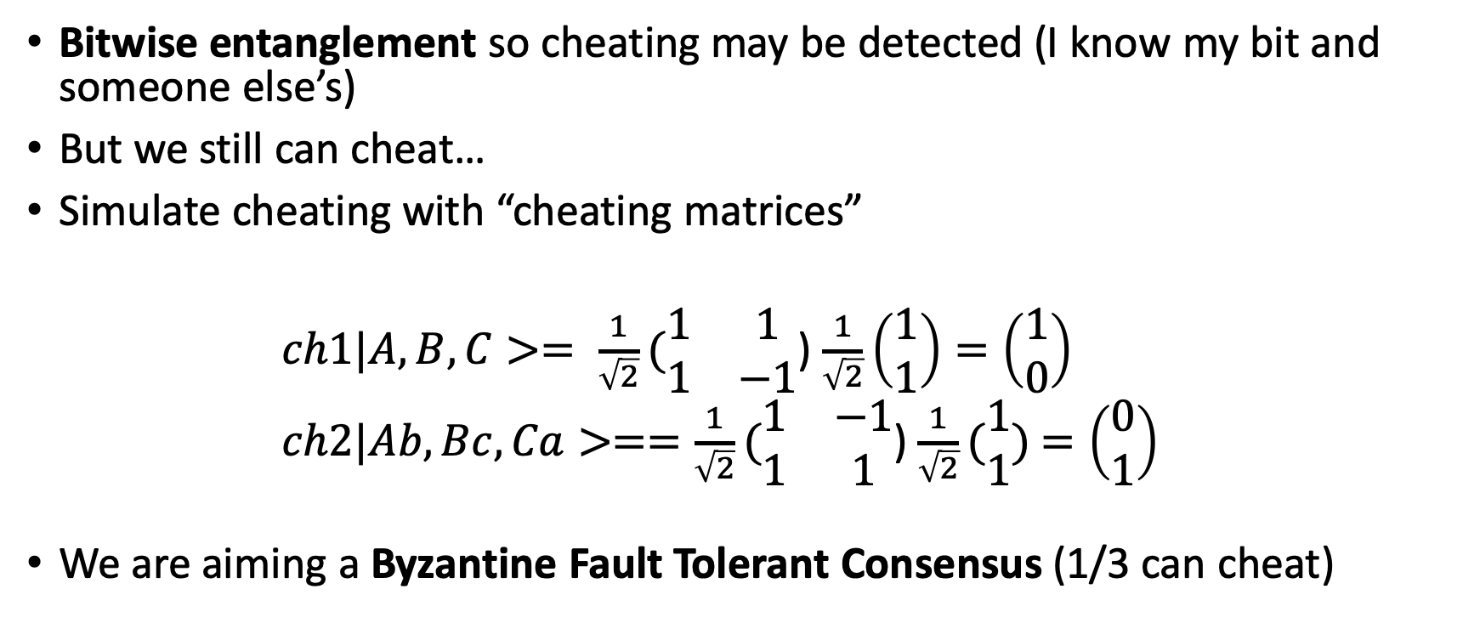
Q Rock-Paper Consensus (QRP-consensus)
Bitwise entanglement so cheating may be detected (I know my bit and someone else’s)
But we still can cheat…
Simulate cheating with “cheating matrices”
$ch1|A,B,C>= \frac{1}{\sqrt{2}}(\begin{matrix}1 & 1 \\ 1 & −1\end{matrix}$) $\frac{1}{\sqrt{2}}\left(\begin{matrix}1 \\ 1\end{matrix}\right)=\left(\begin{matrix}1 \\ 0\end{matrix}\right)$
$ch2|Ab,Bc,Ca>==\frac{1}{\sqrt{2}}(\begin{matrix}1 & −1 \\ 1 & 1\end{matrix}$) $\frac{1}{\sqrt{2}}(\begin{matrix}1 \\ 1\end{matrix})$ $=\left(\begin{matrix}0 \\ 1\end{matrix}\right)$
We are aiming a Byzantine Fault Tolerant Consensus (1/3 can cheat)

Slide 16
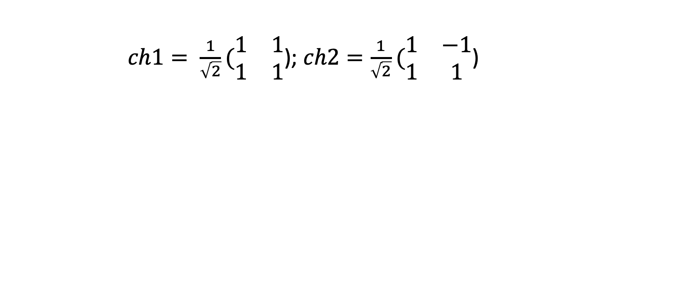
Q Rock-Paper Consensus (QRP-consensus)
$ch1= \frac{1}{\sqrt{2}}(\begin{matrix}1 & 1 \\ 1 & 1\end{matrix}$); $ch2=\frac{1}{\sqrt{2}}(\begin{matrix}1 & −1 \\ 1 & 1\end{matrix}$)

Slide 17
What else? Future work.
Quantum Key Distribution in real devices with parity bit.
Enhanced QRP consensus where cheating is penalized. Test it in a real setup.
QRPS (Rock-Paper-Scissors) consensus with encoded 3-D Qudits
Learn more about quantum and qiskit! And publish a paper? We’ll see.

